Slide 1
VIDEOCLUB
Group Project CB12PTJS
Nektarios Banousi Anastasia Kounoupi Grigoris Palaiohoritis

Slide 2
Cooperative project developed for Peoplecert’s Coding Bootcamp, with the target of designing and implementing a functional streaming platform web application as part of a 3 developer team. Technologies used include:
Sails.js
bcryptjs
PayPal-Checkout
MySQL
JavaScript
jQuery
EJS
SASS

Slide 3
Anastasia Kounoupi
Front-End
Nektarios Banousi
Back-End
Grigoris Palaiohoritis Database

Slide 4
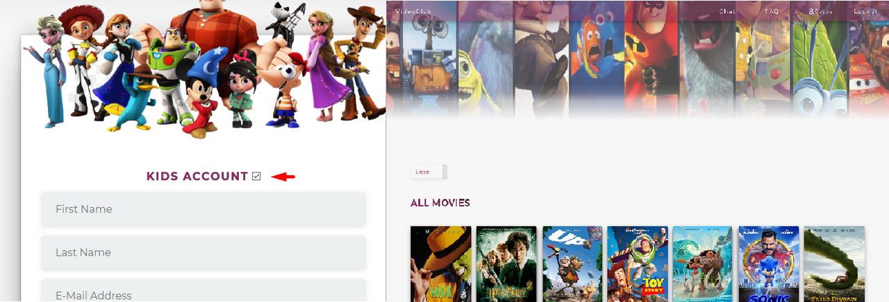
2 user roles:
Adult user
Child user

Slide 5
What are you actually able to do
The logged in user is authenticated and encrypted with bcrypt, that way even one with access to the database can't see what it is. Once the user logs in, he/she can access a list of movies that are available for renting. The user can then click on a movie, and will be redirected to the movie-detail page that contains the movies' info like, description, price, rating, and the movie trailer. To proceed the user must click the "Watch Now" button and will be redirected to a checkout page, powered by Paypal. After the payment is confirmed that user is redirected to a page that contains the purchased movie.
In the prospect that this can be a subscription for children, the account can be kid-friendly. That means that if the user is a child, the account has access ONLY to titles that are either animation, or in the perspective PG rating.

Slide 6
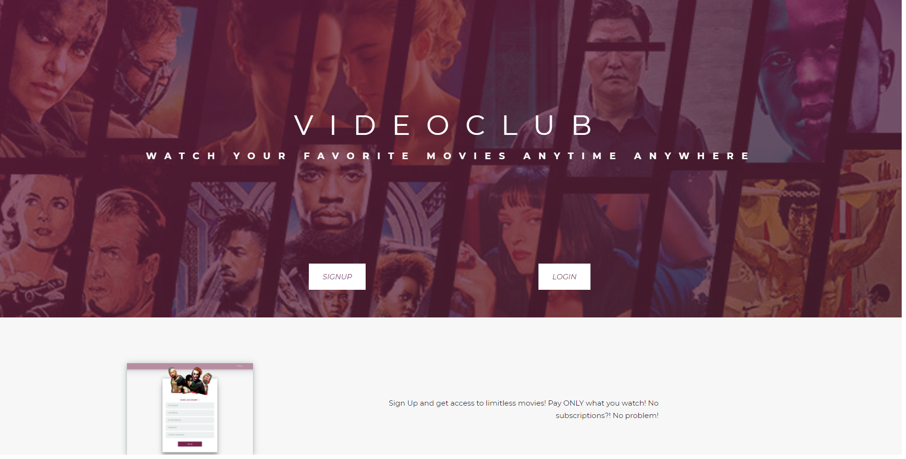
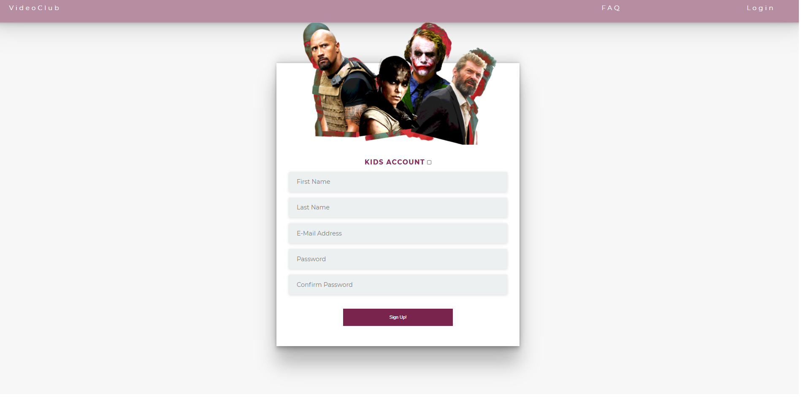
Homepage
Sign up

Slide 7
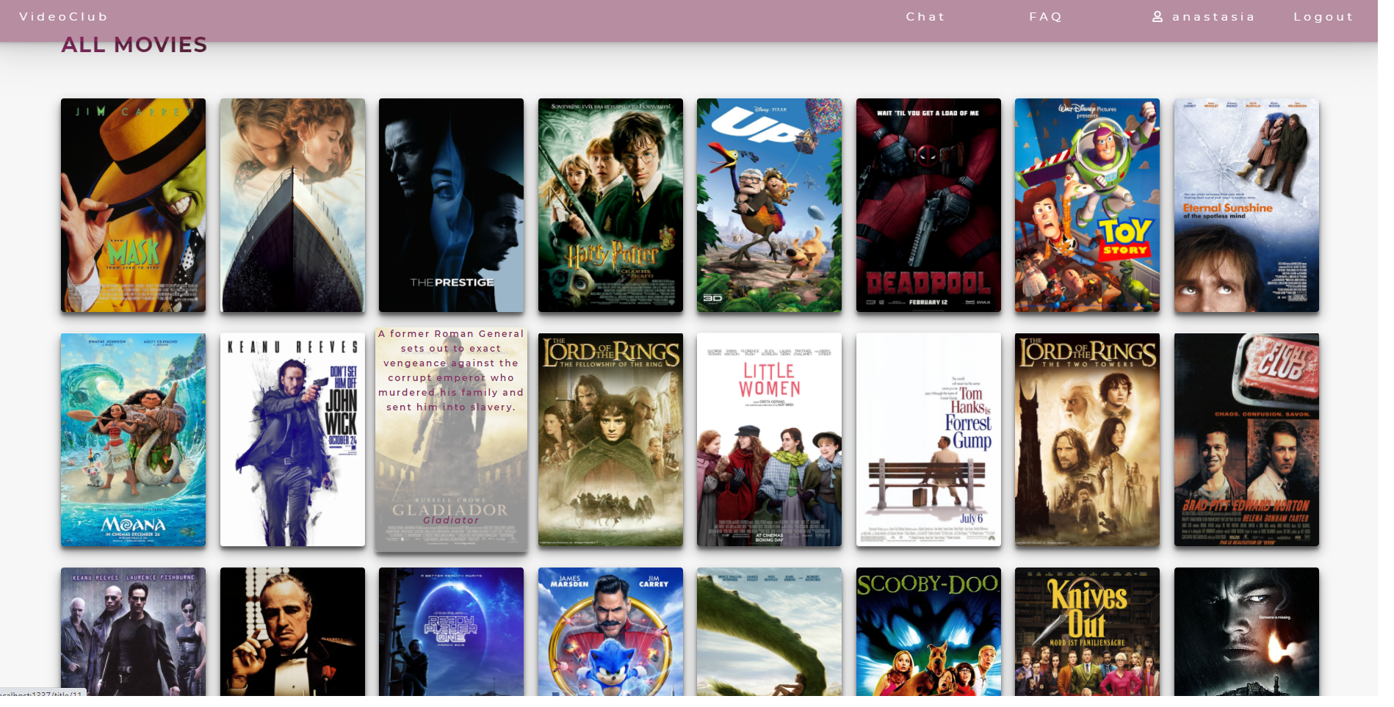
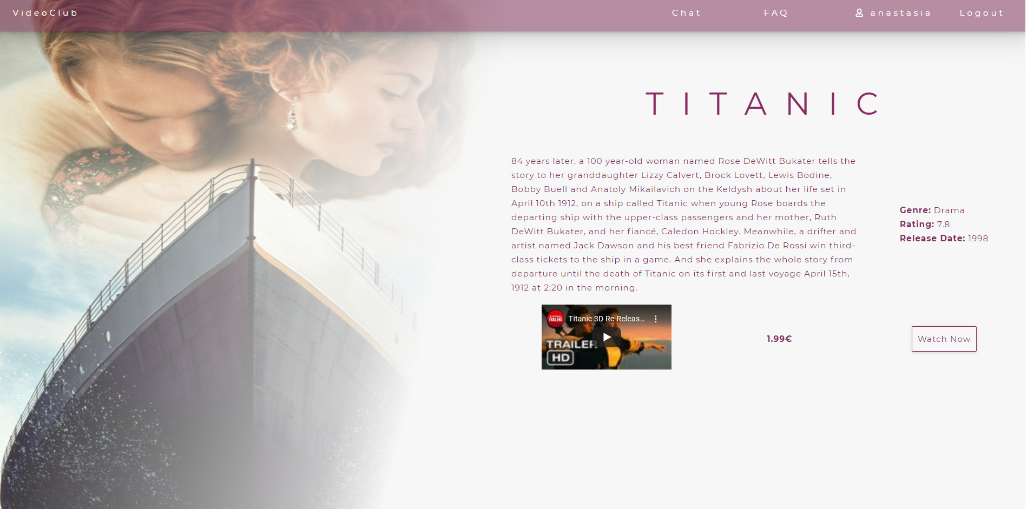
Movies Page
Movie Details

Slide 8
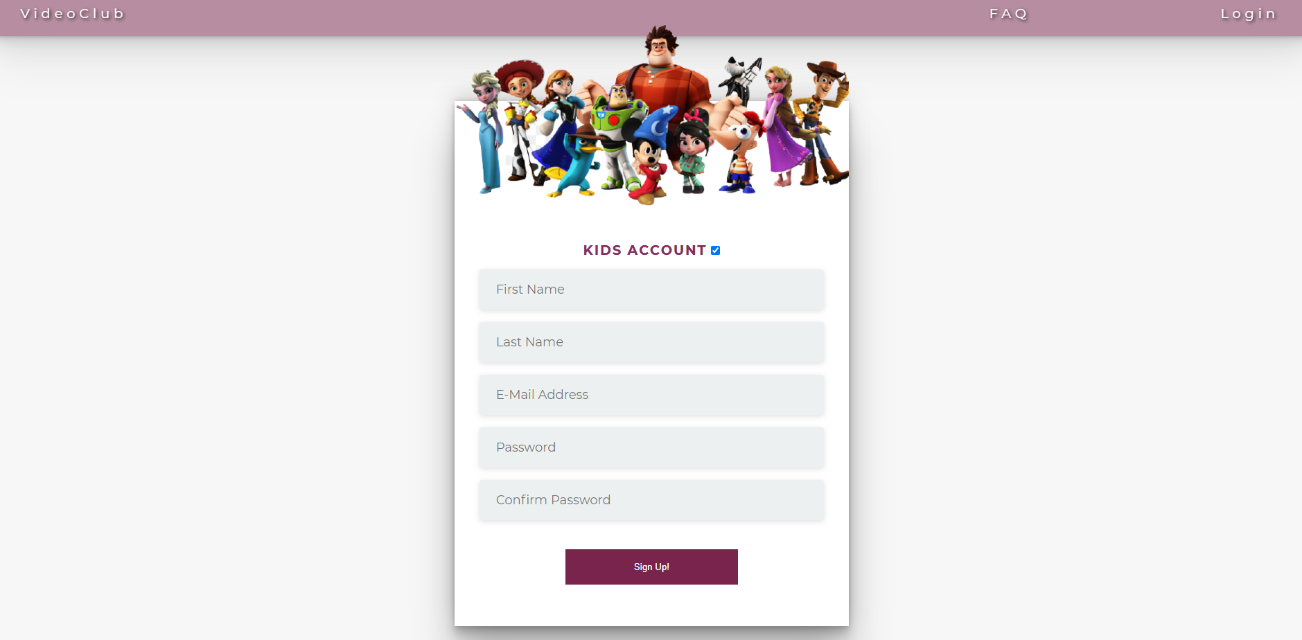
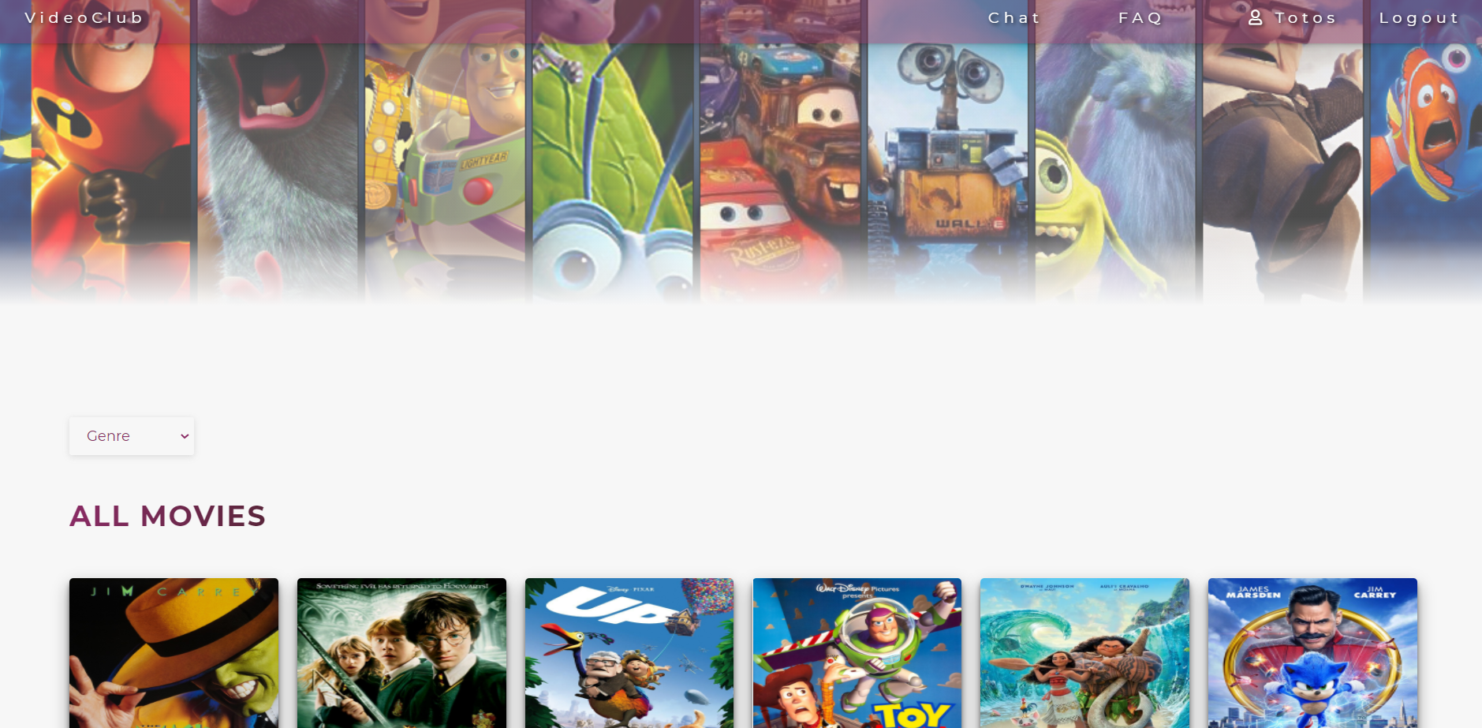
You can sign up for a Kids Account
And get access only to movies appropriate for children

Slide 9
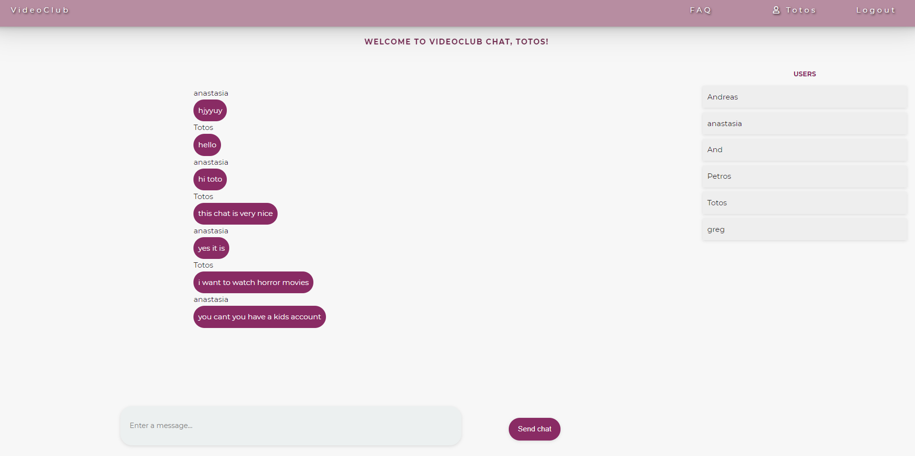
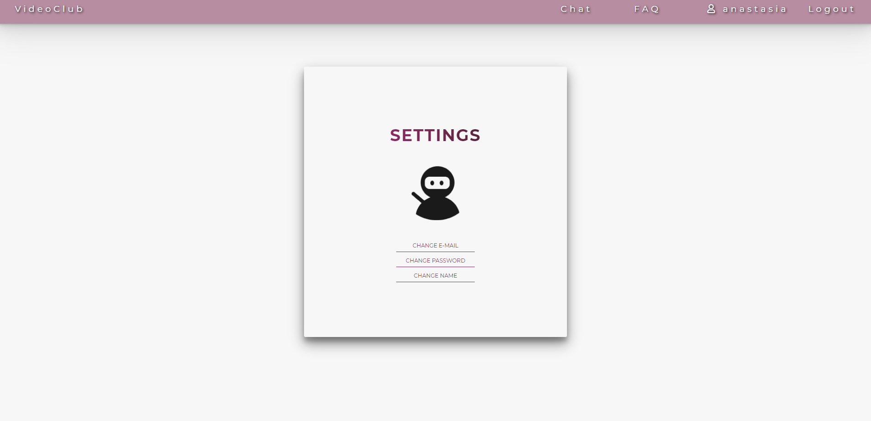
Chat with other users
Account setting

